Slide 1
Bigdata analytics on the public cloud: Challenges and opportunities
Jian Zhang, jian.zhang@intel.com
Yuan Zhou, yuan.zhou@intel.com
Chendi Xue, chendi.xue@intel.com
May, 2019

Slide 2
Agenda
Background and motivation
Bigdata analytics on the cloud: the challenges & optimizations
Accelerate bigdata analytics on cloud with in memory data accelerator (IMDA)
  IMDA as Cache
  IMDA as shuffle
Summary

Slide 3





Challenges of scaling Hadoop* Storage
BOUNDED Storage and Compute resources on Hadoop Nodes brings challenges
Data Capacity
Silos
Costs
Performance & efficiency
Typical Challenges
Data/Capacity
Multiple Storage Silos
Space, Power, Utilization
Inadequate Performance
Upgrade Cost
Provisioning and Configuration
*Other names and brands may be claimed as the property of others.
Notes:
Hadoop is a bounded architecture, where storage and compute share the same physical nodes.
However, Data volume is growing at an fast rate, often without consummate growth in computation needs. Storage as a critical component will continue to shape and be shaped by how businesses deploy the infrastructure for Big Data analytics
Traditional scale-out infrastructures might no longer adequate, as it starts to exhibit significant challenges in the areas of manageability, flexibility, and cost as the number and size of these deployments grow. There are multiple challenges faced today, like data capacity, data silos, cost and performance & efficiency.
As compute and storage are coupled, and storage needs are growing, usually the data/capacity is not enough.
As the value of big data grows within enterprises, so does the number and size of the workloads being deployed. This leads to multiple application clusters being created, and the resources become “siloed” in separate clusters.
It is difficult to ascertain the correct footprint up-front when planning the deployment of a new workload or cluster. To avoid further delays from re-configuring systems, people will often over-provision resources, which leads to wasteful space, power utilization, and increase Cost
Data growth is unpredictable and in many cases it can grow exponentially. So it is very possible to find that the workloads requires more processing/storage power even with over-provision, which leads to inadequate performance without expanding the cluster.
Last but not least, manageability cost: Reconfiguring, provisioning the system and updated software with be time consuming.
The next generation of scale-out infrastructure must provide flexibility and simplicity, allowing the users to focus on delivering higher-level revenue-generating services to their customers instead of low leveling of management of the infrastructure.

Slide 4

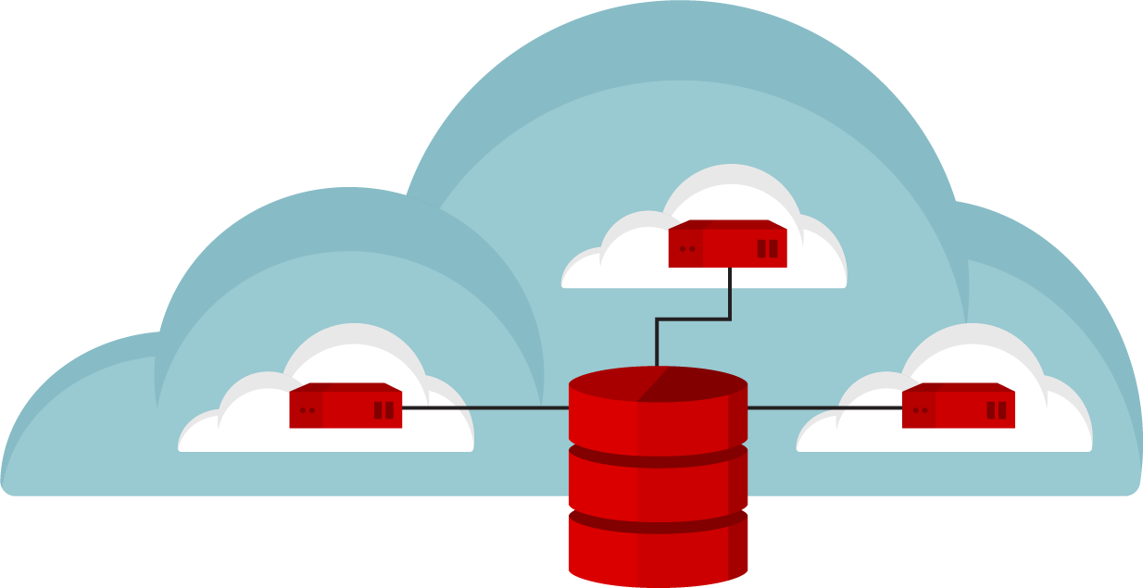
Discontinuity in bigdata infrastructure makes different solution
ON DEMAND ANALYTIC CLUSTERS
SINGLE LARGE CLUSTER
MULTIPLE SMALL CLUSTERS
Get a bigger cluster
for many teams to share.
Give each team their
own dedicated cluster,
each with a copy of
PBs of data.
Give teams ability to
spin-up/spin-down
clusters which can
share data sets.
Notes:
Those challenges lead to a discontinuity in bigdata infrastructure:
MULTIPLE TEAMS COMPETING: and sharing the same big data resources, leads to CONGESTION, and in busy analytic clusters; causing missed SLAs.
This make the customers to pick up different solutions:
#1： Lacks isolation： noisy neighbors hinder SLAs.； Lacks elasticity： single rigid cluster.
#2： No dataset sharing： Cost of duplicate storage； Still lacks elasticity； Can’t scale
#3, Give teams their own compute clusters, it HIT SERVICE-LEVEL AGREEMENTS
Share data sets across clusters instead of duplicating them, it avoid over provision.
By right-sizing de-coupled compute and storage, it ELIMINATE IDLE RESOURCES.
With spin-up/spin-down clusters, it increases AGILITY：

Slide 5
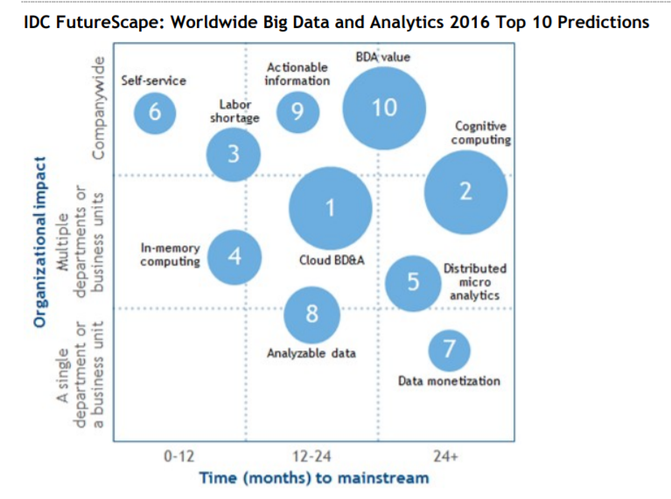
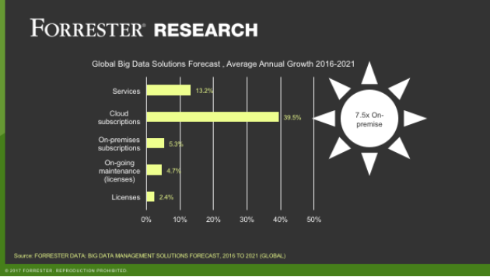
Cloud based Bigdata Analytics Market Trend
IDC No.1 Big Data and analytics predictions
  Through 2020, spending on cloud-based BDA technology will grow 4.5x faster than spending for on-premises solutions [1]
FORRESTER: Public cloud adoption is the No. 1 priority for technology decision makers investing in big data.[2]
Cloud-based big data services offer all the same benefits associated with other public cloud services.
  Agility, Flexibility, access data from everywhere, easy provisioning and management, cost benefits.
  Well suited for BDA for scalability
Source: IDC FutureScape: Worldwide Big Data and Analytics 2016 Predictions
Source: https://www.oracle.com/webfolder/s/delivery_production/docs/FY16h1/do
Notes:
According to IDC, worldwide revenues for big data and business analytics are likely to grow from $150.8 billion in 2017 to $210 billion in 2020. That's a compound annual growth rate of 11.9 percent.
Similarly, Gartner has noted "Cloud-based big data services offer impressive capabilities like rapid provisioning, massive scalability and simplified management."
And in the Oracle- and Intel-sponsored report, Forrester wrote, "companies that move more into the cloud for big data analytics achieve greater innovation, increased integration, and higher levels of security."

Slide 6
Benefits of bigdata analytics on the cloud
Independent scale of compute and storage
Rightsized HW for each layer
Reduce resource wastage
Single copy of data
Multiple compute cluster share common data repo/lake
Simplified data management
Agile application development
In-memory cloning
Hybrid cloud deployment
Simple and flexible software management
Cost saving
Reduced provisioning overhead
Improve security
Snapshot service
Quick & efficient copies
Mix and match resources depending on workload nature and life cycle
Avoid software version management
Upgrade compute software only
Notes:
Decoupled mode allows separation of compute and storage. This enables users to rightsize hardware for each layer. Users can buy high CPU and memory configuration for
the compute nodes, and the storage nodes can be optimized for capacity.
By decoupling compute and storage, multiple compute clusters running Hadoop, Spark,Kafka, MongoDB, Cassandra, or data science tools like TensorFlow can share access to a common data repository/data lake. This leads to cost savings in storage capacity.
You could use an enterprise-grade shared storage with consistent performance and a rich set of data services for simplified data management and reduction in provisioning overheads. This could also help simplify and improve security by using shared storage data-at-rest encryption capabilities
https://databricks.com/blog/2017/05/31/top-5-reasons-for-choosing-s3-over-hdfs.html

Slide 7










Bigdata ANALYTICS on the cloud ecosystem
Hadoop Compatible File System abstraction layer: Unified storage API interface Hadoop fs –ls s3a://job/
s3://
s3n://
gs://
wasb://
adl://
oss://
s3a://
2006
2008
2014
2015
2016
Notes:
On the open source community side, through Hadoop compatible fielssytem abstraction layer, you can run your bigdata workloads on top of multiple storage or cloud solutions.

Slide 8
Agenda
Background and motivation
Bigdata analytics on the cloud: the challenges & optimizations
Accelerate bigdata analytics on cloud with in memory data accelerator (IMDA)
  IMDA as Cache
  IMDA as shuffle
Summary

Slide 9
Storage disaggregation

Slide 10






Architectures – Storage Disaggregation
Batch
Streaming
Interactive
Graph Analytics
Machine Leaning
Shared Data Lake
Replace HDFS with Shared data lake

Slide 11
Functionality: Improve Query Success Ratio with trouble-shootings
tuned
Lots of tunings & trouble shootings required to achieve 100% success ratio for selected TPC-DS queries
  Improper Default configuration
  Wrong middleware configuration
  Improper Hadoop/Spark configuration for different size and format data issues

Slide 12
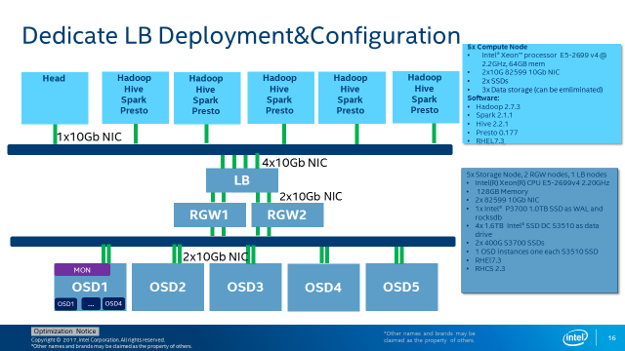
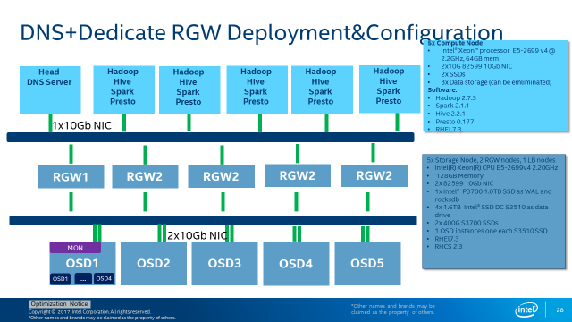
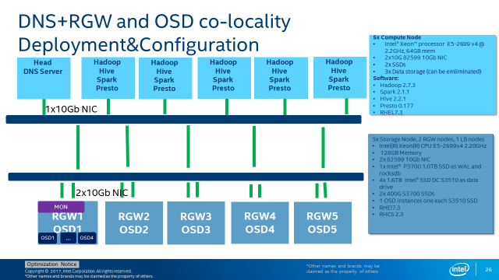
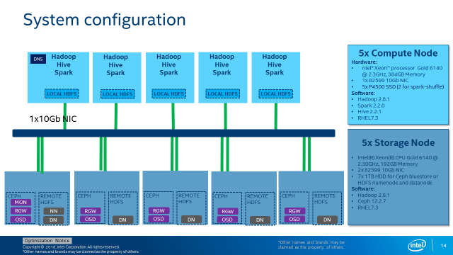
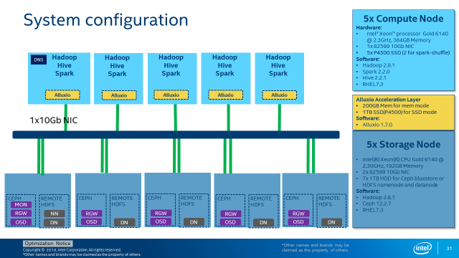
Deployment Architecture: Multiple choices
Deployment Architecture depends on detail HW configuration, application and cost reqruiements

Slide 13
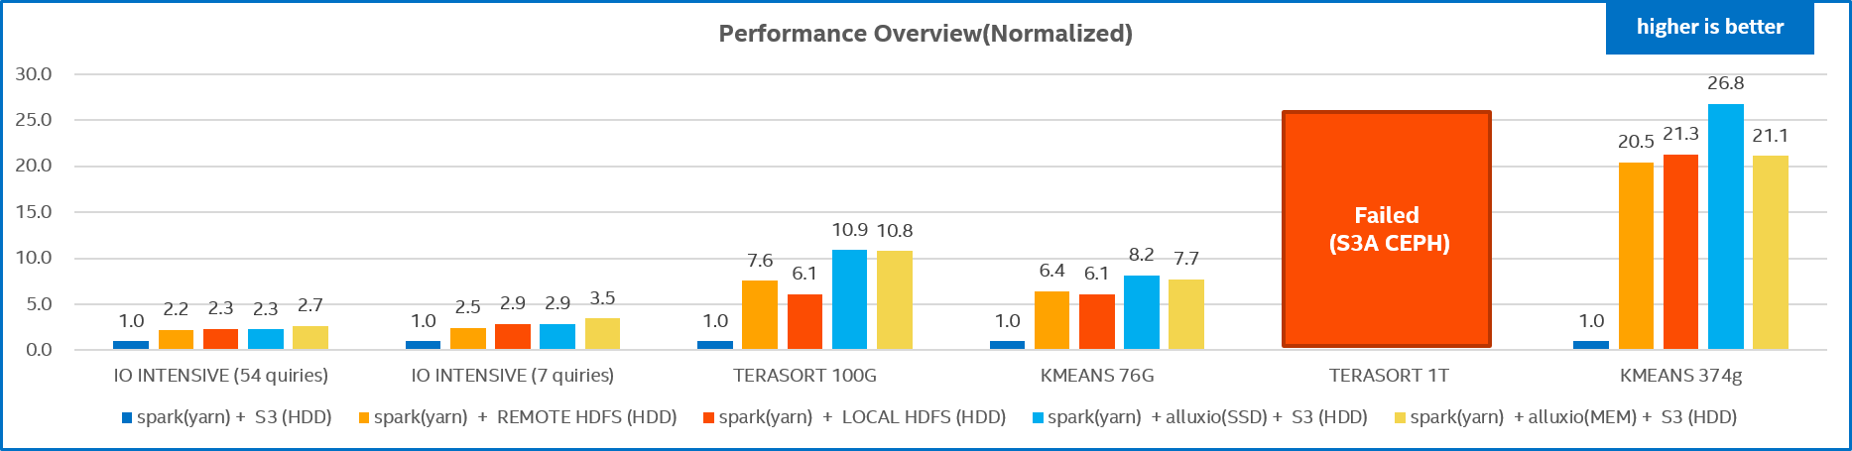
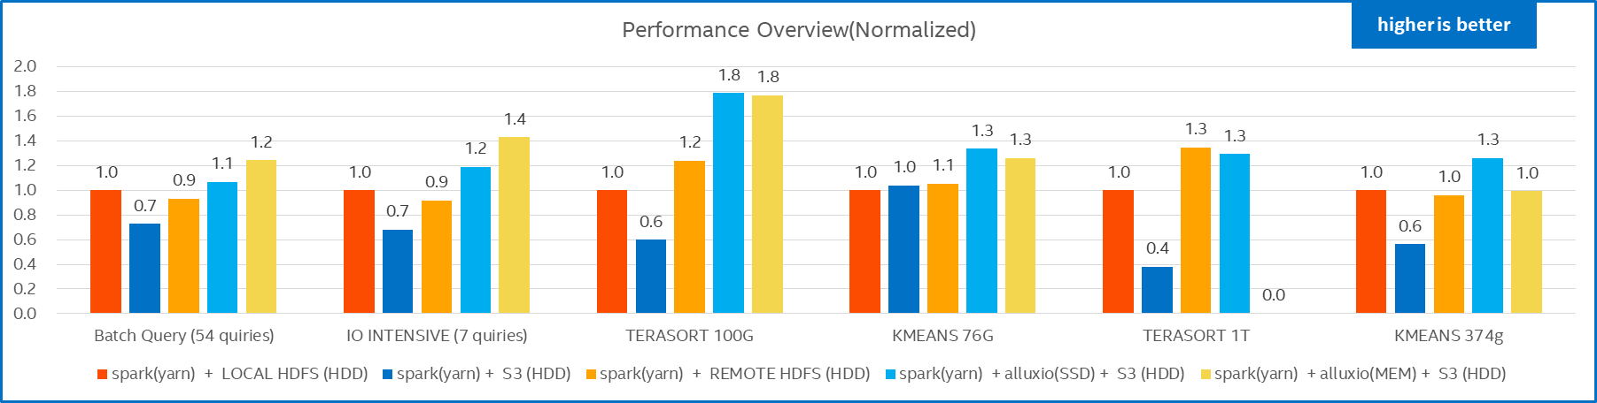
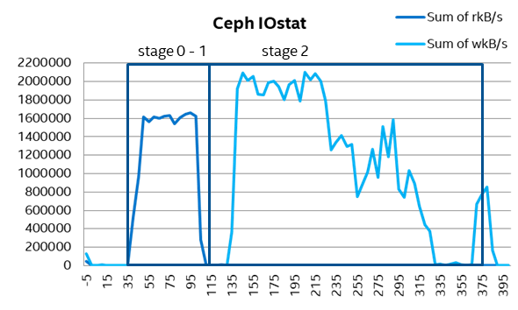
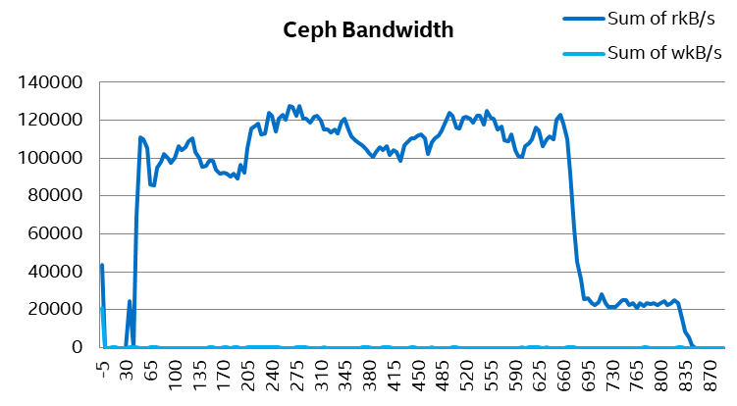
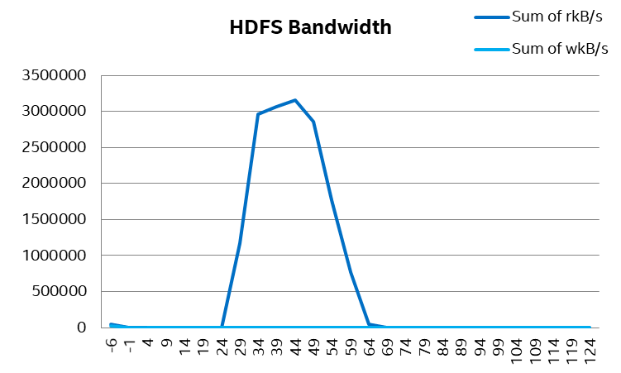
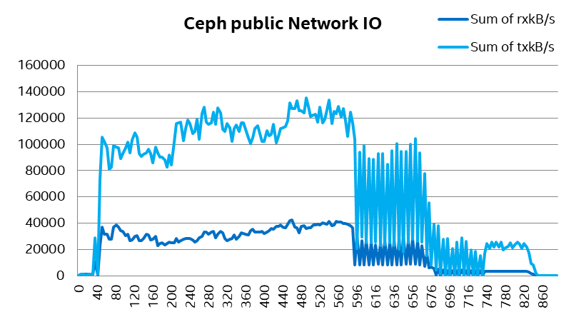
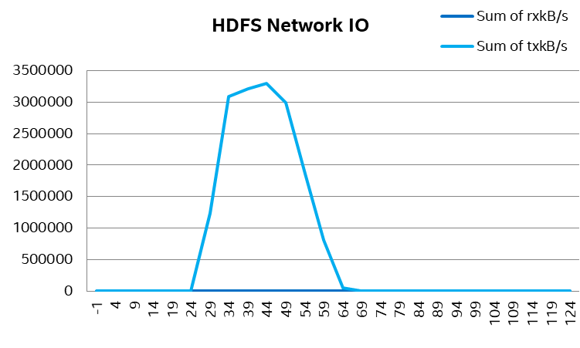
cloud adaptor tunings: S3a as an example
S3A performance is dramatically worse than HDFS
S3A 11.5x improved!!
S3A Ceph
Remote HDFS
S3A Ceph
stage 0
stage > 0
stage 0
stage > 0
From disk io and network io data, we can see read Bandwidth on Ceph is extremely low, about 100MB/s vs. 3GB/s on HDFS.
And based on our experience, Ceph is capable drive disk BW to more than 2GB/s.
S3A adaptor is the bottleneck.
Took 820secs with BW of 120MB/s
Tuning up readahead range will decrease S3A opened connections.
stage 0
stage > 0
<property>
<name>fs.s3a.readahead.range</name>
<value>1024K</value>
</property>
<property>
<name>fs.s3a.experimental.input.fadvise</name>
<value>random</value>
</property>
Notes:
S3A has added support for configurable input policies. Similar to fadvise, this configuration provides applications with a way to specify their expected access pattern (sequential or random) while reading a file. S3A then performs optimizations tailored to that access pattern.
Currently file's "contentLength" is set as the "requestedStreamLen", when invoking S3AInputStream::reopen(). As a part of lazySeek(), sometimes the stream had to be closed and reopened. But lots of times the stream was closed with abort() causing the internal http connection to be unusable. This incurs lots of connection establishment cost in some jobs. It would be good to set the correct value for the stream length to avoid connection aborts.

Slide 14
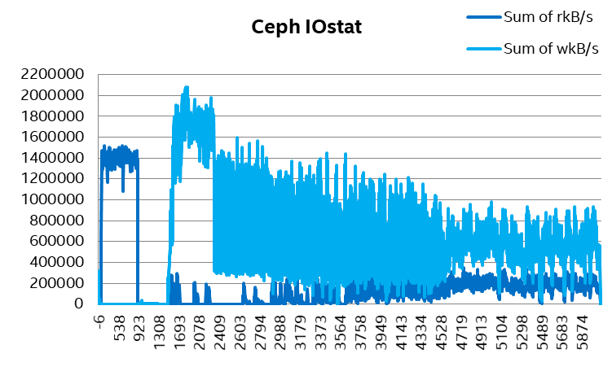
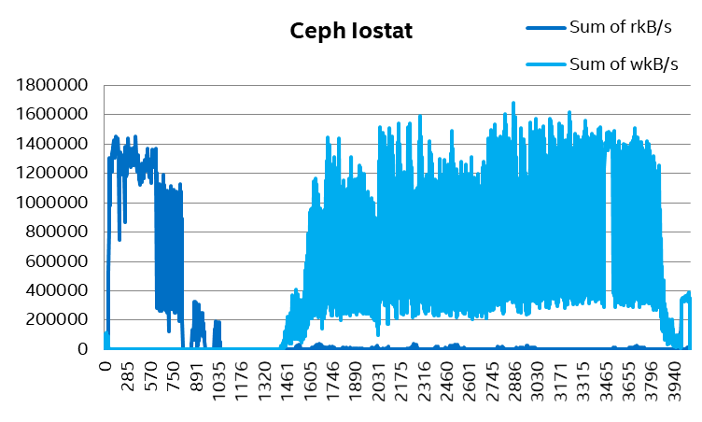
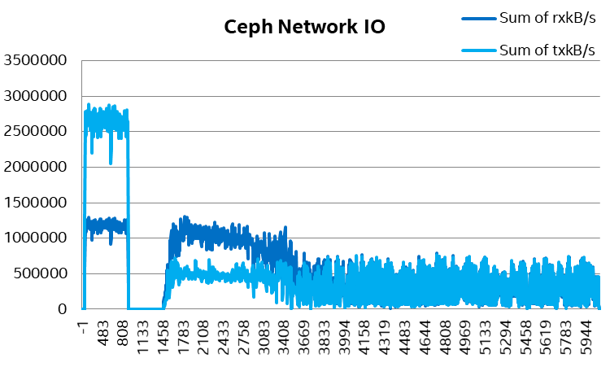
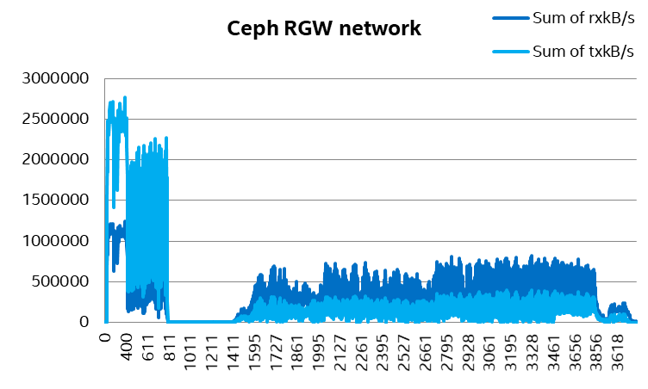
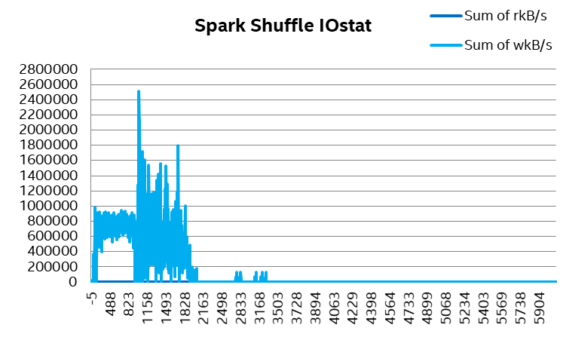
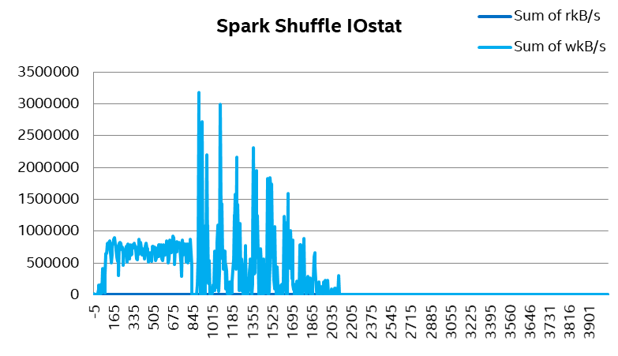
cloud adaptor tunings: S3a committer
S3A committer
Since Hadoop 3.1.1
Leverage multipart upload (“MPU”) mechanism:
  The individual tasks in a job write their data to S3 as POST operations within multipart uploads, yet do not issue the final POST to complete the upload, then committed in the job commit process.
  W/ S3A committer(staging committer), Terasort 1T process time dropped from 5900 sec to 3900 sec. 1.5x performance improved. While still saw 40% performance degradation compared with HDFS.
S3A Ceph
S3A Committer
Stage 0 - 1
stage 2
stage 1
stage 2
No read at stage 2
Stage 0 - 1
stage 2
stage 1
stage 2
Stage 0 - 1
stage 2
stage 1
stage 2
1.5x improved
Notes:
S3A committer: allows the output of MapReduce and Spark jobs to be written directly to S3, with a time to commit the job independent of the amount of data created.
Multiple committers exists today, They differ in how they deal with conflict and how they upload data to the destination bucket —but underneath they all share much of the same code.

Slide 15
Performance gaps: System configurations
5x Compute Node
Hardware:
ntel® Xeon™ processor Gold 6140 @ 2.3GHz, 384GB Memory
1x 82599 10Gb NIC
5x P4500 SSD (2 for spark-shuffle)
Software:
Hadoop 2.8.1
Spark 2.2.0
Hive 2.2.1
RHEL7.3
DNS
Hadoop
Hive
Spark
Hadoop
Hive
Spark
Hadoop
Hive
Spark
Hadoop
Hive
Spark
Hadoop
Hive
Spark
LOCAL HDFS
LOCAL HDFS
LOCAL HDFS
LOCAL HDFS
LOCAL HDFS
HDD
…
HDD
HDD
…
HDD
HDD
…
HDD
HDD
…
HDD
HDD
…
HDD
5x Storage Node
Intel(R) Xeon(R) CPU Gold 6140 @ 2.30GHz, 192GB Memory
2x 82599 10Gb NIC
7x 1TB HDD for Ceph bluestore or HDFS namenode and datanode
Software:
Hadoop 2.8.1
Ceph 12.2.7
RHEL7.3
CEPH
REMOTE
HDFS
CEPH
REMOTE
HDFS
CEPH
REMOTE
HDFS
CEPH
REMOTE
HDFS
CEPH
REMOTE
HDFS
RGW1
RGW2
RGW3
RGW4
RGW5
MON
Name
Node
7 OSDs
7 Data
Nodes
7 OSDs
7 Data
Nodes
7 OSDs
7 Data
Nodes
7 OSDs
7 Data
Nodes
7 OSDs
7 Data
Nodes
HDD
…
HDD
HDD
…
HDD
HDD
…
HDD
HDD
…
HDD
HDD
…
HDD
*Other names and brands may be claimed as the property of others.

Slide 16
Performance gaps: usage cases
Simple Read/Write
  Terasort: a popular benchmark that measures the amount of time to sort one terabyte of randomly distributed data on a given computer system.
TPC-DS derived tests:
Batch Analytics
  To consistently executing analytical process to process large set of data.
  UC11: Leveraging 54 derived from TPC-DS * queries with intensive reads across objects in different buckets
  I/O intensive queries: selected 9 I/O intensive queries from TPC-DS
  Kmeans
  K-means is one of the most commonly used clustering algorithms that clusters the data points into a predefined number of clusters.
Interactive query
clusters
Batch
query
clusters
Platinum SLA
Silver SLA
Ingest
cluster
ETL
Transformation
cluster
Spark SQL
compute
Bronze SLA
Impala
compute
Gold SLA
Compute resource pool
Disaggregated Storage

Slide 17
Performance gaps
Storage disaggregation leads to performance regression
  Up to 10% for remote HDFS, Terasort performance is higher as usable memory increased
  Up to 60% for S3 object storage (optimized results, up to 11.5x perf. boost through tunings compared with default parameters)
One important cause for the performance gap: s3a does not support Transactional Writes
  Most of bigdata software (Spark, Hive) relies on HDFS’s atomic rename feature to support atomic writes
  During job submit, commit protocol is used to specify how results should be written at the end of job
  First stage task output into temporary locations, and only moving (renaming) data to final location upon task or job completion
  S3a implements this with: COPY+DELETE+HEAD+POST
  The gap in public cloud will be much smaller
  It is not an on-premise configuration, Compute are running in side VMs/containers, while HDFS was running on elastic block volumes
Notes:
There is no rename operation; it is mimicked in the S3A client by listing a directory and copying each file underneath, one-by-one.

Slide 18
Compute orchestration

Slide 19
Architecture – Compute orchestration
Batch
Streaming
Interactive
Graph Analytics
Machine Leaning
Batch
Streaming
Interactive
Graph Analytics
Machine Leaning
Provisioned Compute Pool w/ K8s
Shared Data Lake with s3a object storage
Shared Data Lake with s3a object storage
Replace HDFS with disaggregated s3 object storage
Compute services in Kurbernetes

Slide 20
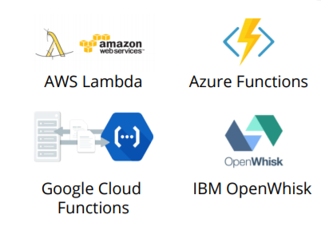


Serverless: Enabling faster business transformation
</>
</>
Abstraction of Platform from End User
</>
</>
Efficiency of Infrastructure Operations
Functions/FaaS
-Higher scale & abstraction
-Eliminates infrastructure management, no DevOps
Containers/PaaS
-Eliminates common overheads
-Abstracts the OS
VM1
VM2
Virtual Machines/IaaS
-Increases CPU utilization
-Abstracts the hardware
Bare Metal Hardware
-Abstracts the physical hosting environment
Notes:
The core building block of Compute on Demand within the data center is Function-as-a-Service (FaaS). FaaS is the latest step in scaling the efficiency of infrastructure applications (that evolved from bare metal → virtualization → containers→FaaS). With FaaS, developers focus on their application code, and submit that to a CSP for compilation and placement. Developers use an event trigger to signal to the CSP that it is time for a particular function to run. With FaaS, higher scale and abstraction is possible. The developer focuses on coding revenue-generating services to market and is freed from the burden of infrastructure management or DevOps.
There are a few key players in the FaaS ecosystem at this time. It is dominated by AWS who launched their FaaS platform, Lambda, in November 2014 though many CSPs now have FaaS solutions. There are no clear leaders outside the T1 CSPs, and the open source ecosystem (OpenWhisk, KubeLess, etc.) is nascent.
As cloud started, a couple of years ago there was the concept of bare metal hardware that abstracted the physical hosting environment.
As it evolved, virtual machines started being used to increase CPU utilization & abstract hardware. This also came to be known as IaaS.
After virtual machines & IaaS, the concept of containers or PaaS was introduced where the OS was abstracted to eliminate common overheads.
Today, we’re at a more granular concept with functions or FaaS.
By writing quick functions, developers do not need to worry about infrastructure management. You can scale on demand as well.
FaaS is a code execution platform.
Billing is based on execution time of the code (function), not on the time required to build and maintain the underlying server infrastructure.
Sources:
http://blog.spotinst.com/2017/05/01/spotinsts-ceo-takeouts-serverlessconf-2017/
https://read.acloud.guru/iaas-paas-serverless-the-next-big-deal-in-cloud-computing-34b8198c98a2#.jq0jjctjp
http://www.xoriant.com/system/files_force/webniar/Serverless-Computing.pdf?download=1
http://www.wsj.com/articles/look-ma-no-server-corporate-it-expects-serverless-computing-to-trigger-big-changes-1477509674

Slide 21
Serverless architecture: configuration
5x Compute Node
Intel® Xeon™ processor E5-2699 v4 @ 2.2GHz, 128GB mem
2x10G 82599 10Gb NIC
2x SSDs
3x Data storage (can be emliminated)
Software:
Hadoop 2.8.1
Spark 2.2.0
Hive 2.2.1
Presto 0.177
CentOS 7.5
Head
DNS Server
K8s master
Kubelet
Kubelet
Kubelet
Kubelet
Kubelet
App2 Driver Pod
App1 Executor
Pod
App2 Executor
Pod
App1 Driver Pod
App1 Executor
Pod
1x10Gb NIC
Compute Orchestration
K8s 1.11
3x10Gb NIC
(ECMP)
5x Storage Node, 5 RGW nodes(co-located)
Intel(R) Xeon(R) CPU E5-2699v4 2.20GHz
128GB Memory
3x 82599 10Gb NIC
1x Intel® P3700 1.0TB SSD as joural
4x 1.6TB Intel® SSD DC P3520 as data drive
1 OSD instances one each P3520 SSD
CentOS 7.5
Ceph Jewel
RGW1
OSD1
RGW2
OSD2
RGW3
OSD3
RGW5
OSD5
MON
RGW4
OSD4
OSD1
…
OSD4
*Other names and brands may be claimed as the property of others.

Slide 22
Serverless analytics Performance
Spark on kubernetes delivers similar performance compared with spark on yarn
  Compute service in K8s bring some performance loss for terasort, but gain for Kmeans
Running Compute Services in K8s brings littlie performance impact for typical SQL workloads

Slide 23
Agenda
Background and motivation
Bigdata analytics on the cloud: the challenges & optimizations
Accelerate bigdata analytics on cloud with in memory data accelerator (IMDA)
  IMDA as Cache
  IMDA as shuffle
Summary

Slide 24
Architecture – IN Memory data accelerator
Batch
Streaming
Interactive
Graph Analytics
Machine Leaning
Batch
Streaming
Interactive
Graph Analytics
Machine Leaning
Batch
Streaming
Interactive
Graph Analytics
Machine Leaning
Provisioned Compute Pool w/ K8s
In Memory Data Acclerator
Provisioned Compute Pool
Shared Data Lake with s3a object storage
Shared Data Lake with s3a object storage
Shared Data Lake with s3a object storage
Replace HDFS with disaggregated s3 object storage
Compute services in Kurbernetes
In Memory Accleration layer POC

Slide 25
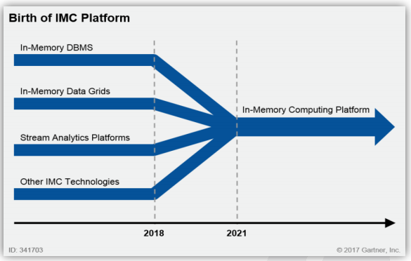
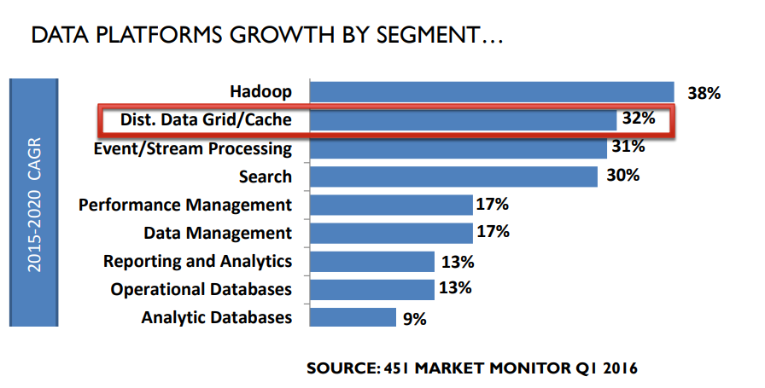
In memory computing and in memory data accelerator
In-Memory Computing Market Worth 23.15 Billion USD by 2020*
“IMC-enabled HTAP can have a transformational impact on the business.”
  In-Memory Computing has emerged due to the collision of massive data growth with internet scale, resulting in an insatiable need for speed and scale
In memory data accelerator (part of Dist. Data grid/Cache) plays a critical role and grows fast among in memory technologies
  Without complex functions data distribution, KV interface, SQL support
  It focuses on Ephemeral data access acceleration, e.g., like cache and shuffle.
Source: https://www.marketsandmarkets.com/Market-Reports/in-memory-computing-820.html
Notes:
HTAP enables real-time analytics and situation awareness on live transaction data as opposed to after-the-fact analysis on stale data (in traditional architectures).
“Increasing processor core counts and the rise of IO-heavy applications such as real-time analytics are driving a need to feed data faster to processors so they are not left idling on the wrong side of an IO bottleneck.” — 451 Research

Slide 26
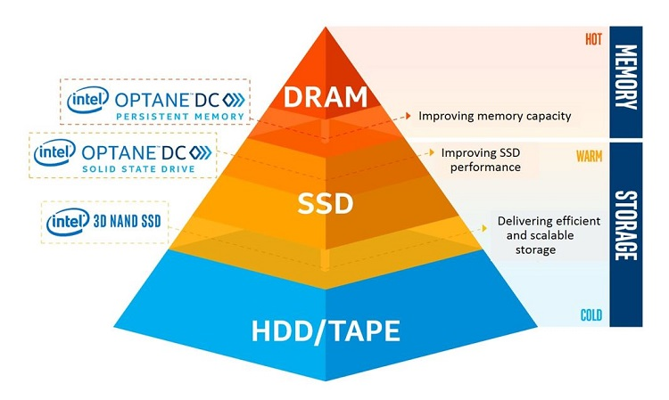
Persistent Memory and RDMA
RDMA: Remote Direct Memory Access
Accessing (i.e. reading from or writing to) memory on a remote machine without interrupting the processing of the CPU(s) on that system.
  Zero-copy - applications perform data transfer without the network software stack involvement, data is being send received directly to the buffers without being copied between the network layers.
  Kernel bypass - applications perform data transfer directly from userspace, no context switches.
  No CPU involvement - applications can access remote memory without consuming any CPU in the remote machine.
Persistent Memory:
PMEM represents a new class of memory and storage technology architected specifically for data center usage
Combination of high-capacity, affordability and persistence.
Picture source: https://software.intel.com/en-us/blogs/2018/10/30/intel-optane-dc-persistent-memory-a-major-advance-in-memory-and-storage-architecture
Notes:
High-capacity persistent memory in the data center allows applications to run without incurring the latency penalty of going out to storage over the PCIe bus. As developers adapt software, this new memory class is designed to enable cost-effective, large-capacity in-memory database solutions; provide greater system uptime and faster recovery after power cycles; accelerate virtual machine storage; deliver higher performance to multi-node, distributed cloud applications; and offer advanced encryption for persistent data built into the hardware.
Remote
data transfers between nodes in a network
Direct
no Operating System Kernel involvement in transfers
everything about a transfer offloaded onto Interface Card
Memory
transfers between user space application virtual memory
no extra copying or buffering
Access
send, receive, read, write, atomic operations

Slide 27
Leveraging In memory data accelerator to accelerate intermediate data access
Applications
Batch
Interactive
Streaming
Graph Analytics
Machine Leaning
…
A new in memory data accelerator layer to accelerate ephemeral data access
  New HW technologies & products emerging delivers significant performance improvement, like persistent memory, RDMA, NVMe over fabrics, SPDK, persistent memory over fabrics
  Bigdata I/O stack is not optimized for new technologies or HWs
  The long I/O stack could hidden the hardware benefits
  It requires a storage and network co-design to fully leverage those technologies or HWs address the bottlenecks
Data
Processing
& Analysis
Flink*
Storm*
DataFrame
ML Pipelines
SQL*
SparkR*
Streaming*
Mllib*
GraphX*
MR*
Giraph*
Spark Core
Resource Mgmt
& Co-ordination
YARN*
k8s*
ZooKeeper*
Acceleration Layer
Alluxio*
Ignite*
Crail*
TBD*
High Speed Networking
Disaggregated
Storage
HDFS*
Ceph*
OSS*
Parquet*
Avro*
Hbase*
Notes:
New storage technology: Persistent Memory, NVMe, SPDK, PMoF has been adopted widely in modern storage systems
Ceph, PolarDB
However Bigdata storage is still using technology 10+ years ago
The long IO stack of Bigdata buried the H/W performance gain
HPC technology are commonly used in Bigdata and Deep Learning
RDMA, GPU/FPGA, IB

Slide 28
IMDA with state-of-art HW
Batch
Streaming
Interactive
Graph Analytics
Machine Leaning
A new storage stack/component enabled with state-of-art technology
  Light-weighted user space I/O based distributed data store
  Persistent Memory to enlarge compute storage with high performance and low cost
  RDMA to avoid context switch, kernel bypass
    Persistent Memory mmap address as RDMA buffer to avoid memory copies
    Persistent Memory as off-heap memory to improve GC
  Customized shuffler for Spark, compute-side cache
  Areas we need to work on:
  S3a adaptor optimization – vendor specific
  In memory data accelerator as cache: POC w/ Alluxio – Persistent Memory enabling
  In memory data accelerator as shuffle: POC w/ RDMA + Persistent Memory – RDMA + Persistent Memory shuffle optimization for Spark, Spark-PMoF
in memory data accelerator
Ephemeral data
RDMA enabled Network
DRAM
Persistent Memory
NVMe SSD
Provisioned Compute Pool
Shared Data Lake with s3a object storage
Notes:
https://www.snia.org/sites/default/files/SDC15_presentations/persistant_mem/ChetDouglas_RDMA_with_PM.pdf
RDMA benefit:
Zero-copy - applications can perform data transfer without the network software stack involvement and data is being send received directly to the buffers without being copied between the network layers.
Kernel bypass - applications can perform data transfer directly from userspace without the need to perform context switches.
No CPU involvement - applications can access remote memory without consuming any CPU in the remote machine. The remote memory machine will be read without any intervention of remote process (or processor). The caches in the remote CPU(s) won't be filled with the accessed memory content.
Message based transactions - the data is handled as discrete messages and not as a stream, which eliminates the need of the application to separate the stream into different messages/transactions.
Scatter/gather entries support - RDMA supports natively working with multiple scatter/gather entries i.e. reading multiple memory buffers and sending them as one stream or getting one stream and writing it to

Slide 29
Agenda
Background and motivation
Bigdata analytics on the cloud: the challenges & optimizations
Accelerate bigdata analytics on cloud with in memory data accelerator (IMDA)
  IMDA as Cache
  IMDA as shuffle
Summary

Slide 30
Alluxio as Cache
Spark
Spark
Spark
Spark
Spark
Spark
Spark
Spark
Spark
Spark
Spark
Spark
Spark executor
Spark executor
Spark executor
Spark executor
Spark executor
Spark executor
Spark executor
Spark executor
Spark executor
Spark executor
Spark executor
… …
Spark executor
Spark shuffle device
Spark shuffle device
Spark shuffle device
Spark shuffle device
Spark shuffle device
Spark shuffle device
Spark shuffle device
Spark shuffle device
Spark shuffle device
Spark shuffle device
Spark shuffle device
Spark shuffle device
Alluxio as cache
Ceph with S3A
Using Alluxio as cache for cloud storage, in this case, we used Alluxio to accelerate ceph with s3a connector.
So when data read from ceph, data will be promoted to spark local Alluxio worker firstly and then to spark executor.
And when data write to ceph, data will be written to local Alluxio worker and then flushed to ceph by specific strategy.

Slide 31
System configurations
5x Compute Node
Hardware:
ntel® Xeon™ processor Gold 6140 @ 2.3GHz, 384GB Memory
1x 82599 10Gb NIC
5x P4500 SSD (2 for spark-shuffle)
Software:
Hadoop 2.8.1
Spark 2.2.0
Hive 2.2.1
RHEL7.3
Alluxio: 2.0.0, 200GB DRAM Cache
DNS
Hadoop
Hive
Hadoop
Hive
Hadoop
Hive
Hadoop
Hive
Hadoop
Hive
YARN
YARN
YARN
YARN
YARN
5 * Spark exec
5 * Spark exec
5 * Spark exec
5 * Spark exec
5 * Spark exec
Alluxio worker
Alluxio worker
Alluxio worker
Alluxio worker
Alluxio worker
CEPH
5x Storage Node
Intel(R) Xeon(R) CPU Gold 6140 @ 2.30GHz, 192GB Memory
2x 82599 10Gb NIC
7x 1TB HDD for Ceph bluestore or HDFS namenode and datanode
Software:
Hadoop 2.8.1
Ceph 12.2.7
RHEL7.3
CEPH
CEPH
CEPH
CEPH
MON
RGW2
RGW3
RGW4
RGW5
RGW1
OSD
OSD
OSD
OSD
OSD
*Other names and brands may be claimed as the property of others.

Slide 32
Performance overview
higher is better
Using Alluxio IMDA as cache:
For terasort, 3.4x speedup over S3 object storage, 1.36x speedup over local HDFS.
For TPCDS test, up to 1.56x performance speedup for IO intensive queries, slightly lower than local HDFS.
For KMeans test, 1.62x speedup over S3 object storage, 14% lower compared with local HDFS.
  KMeans is a CPU intensive workload
Using Alluxio IMDA cache improved in IO intensive workloads but remains headroom in other cases.
Notes:
Why Alluxio has no benefit by TPCDS compared with local HDFS

Slide 33
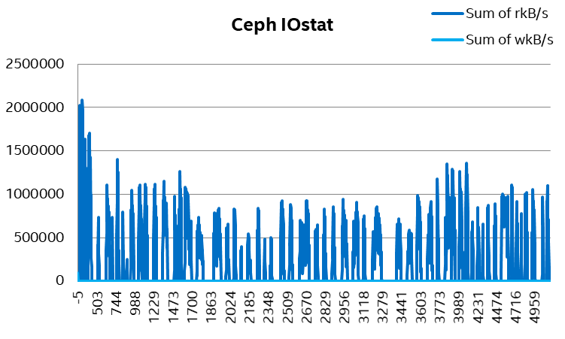
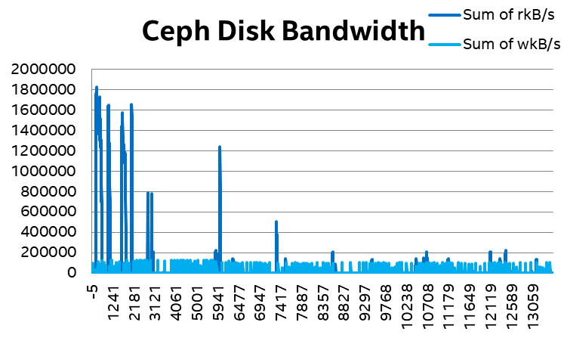
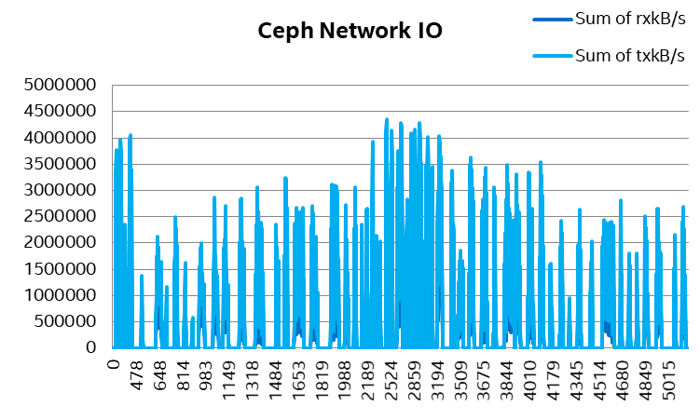
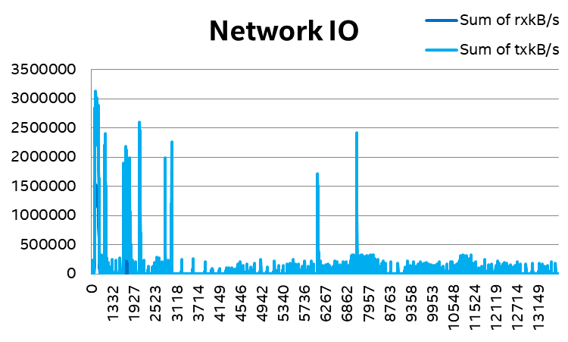
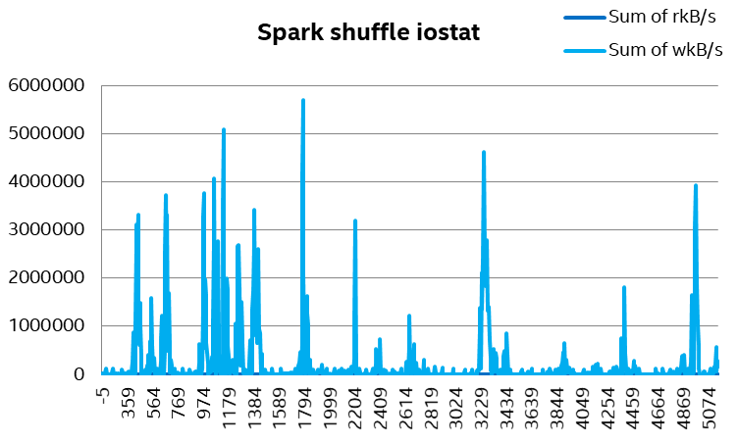
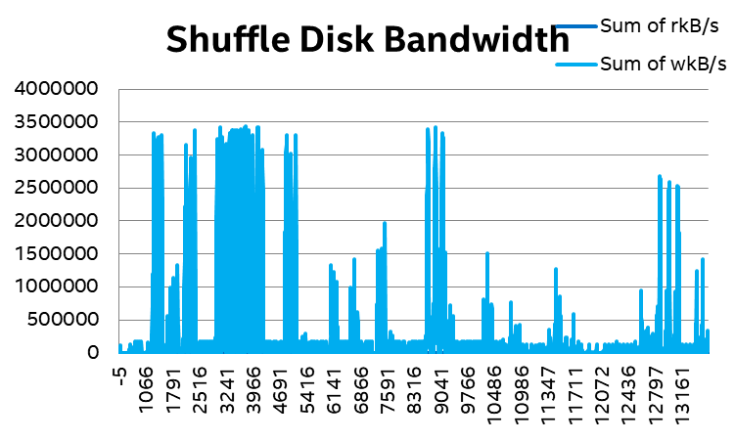
TPCDS
--Disk Statistics
S3A Ceph
S3A Ceph with alluxio
With Alluxio, Ceph disk and network bandwidth is much lower

Slide 34
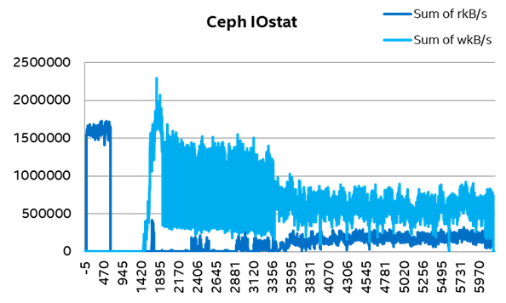
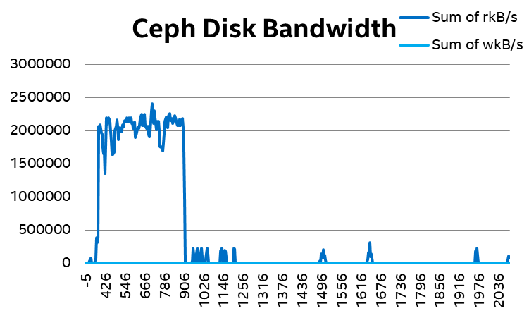
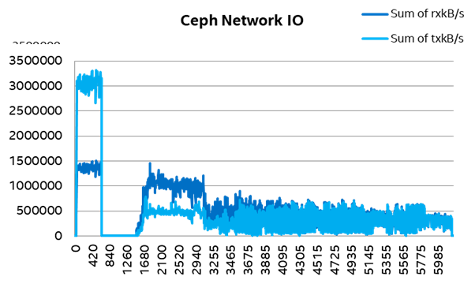
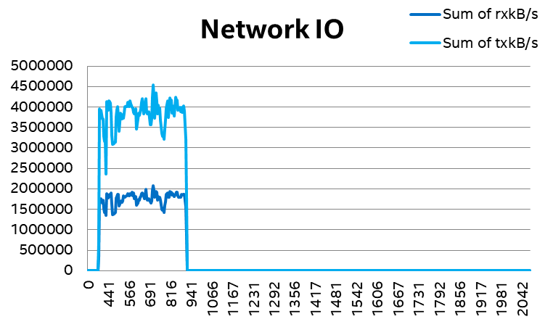
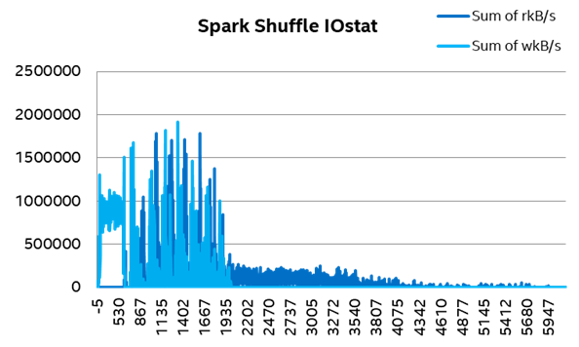
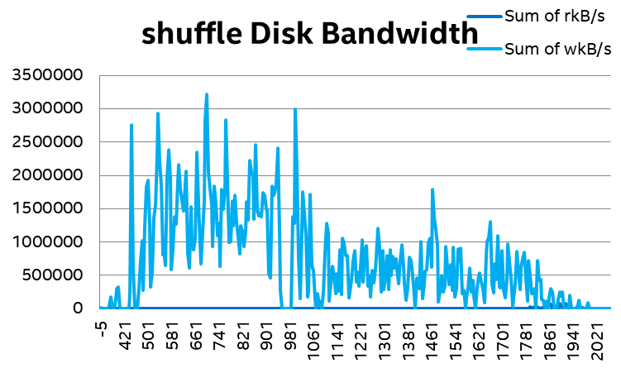
Terasort (1000G)
Disk Statistics
S3A Ceph
S3A Ceph with alluxio
Stage 0 - 1
stage 2
With Alluxio, data output in stage 2 will be written to Ceph asynchronously.
Stage 0 - 1
stage 2
Stage 0 - 1
stage 2

Slide 35
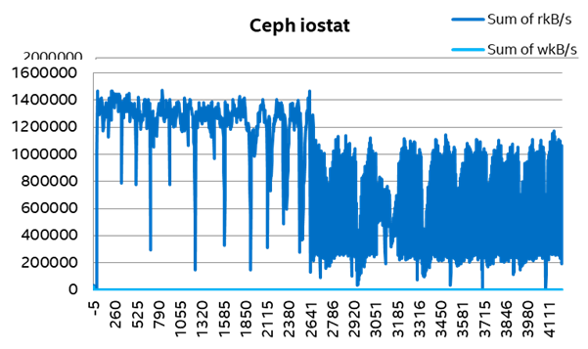
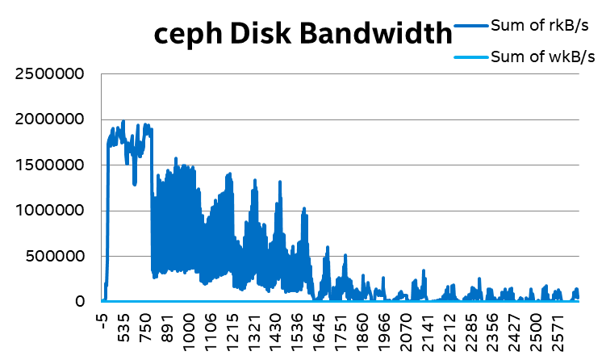
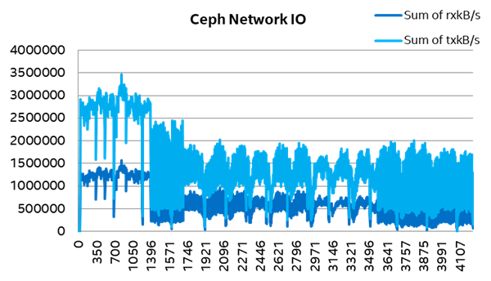
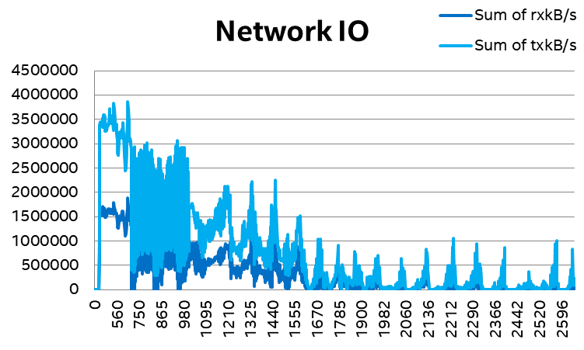
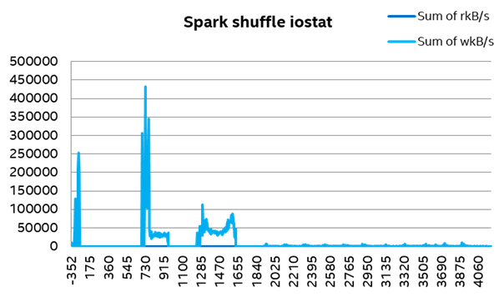
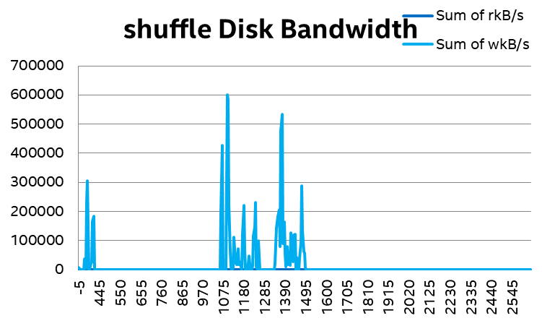
Kmeans (374.6G)
Disk Statistics
S3A Ceph
S3A Ceph with alluxio
stage 1,2
stage 0
stage 3-6
stage 8 - 17
With Alluxio, since data is cached in Alluxio, data won’t need to be repeatedly read from Ceph.

Slide 36
Agenda
Background and motivation
Bigdata analytics on the cloud: the challenges & optimizations
Accelerate bigdata analytics on cloud with in memory data accelerator (IMDA)
  IMDA as Cache
  IMDA as shuffle
Summary

Slide 37
Spark-PMoF Design
Shuffle write
Worker
Worker
Executor JVM #1
Executor JVM #1
Shuffle read
Shuffle Manager
Shuffle Manager
PMEM
1
1
obj
Heap
Shuffle
Writer(new)
obj
Shuffle
Reader(new)
Heap
Shuffle
Writer
Shuffle
Reader
bytebuffer
Off-heap
bytebuffer
PMEM
Off-heap
2
User
2
3
User
Kernel
Spark.Local.dir
Kernel
3
Shuffle file
4
Shuffle file
Drivers
SSD HDD
NIC
PMEM
RDMA NIC
1. Serialize obj to off-heap memory
2. Write to local shuffle dir
3. Read from local shuffle dir
4. Send to remote reader through TCP-IP
Lots of context switch
POSIX buffered read/write on shuffle disk
TCP/IP based socket send for remote shuffle read
Serialize obj to off-heap memory
Persistent to PMEM
Read from remote PMEM through RDMA, PMEM is used as RDMA memory buffer
No context switch
Efficient read/write on PMEM
RDMA read for remote shuffle read

Slide 38
PMoF Design
A new PMoF shuffle manager
Implements both sort & sort bypassmergesortshuffle
Leveraging PMDK libpmemobj library for write with efficient JNI wrapper
Transactional write support ensure high data consistency
Failover support: support multiple executor processes to get multiple PMEM namespace in devdax mode and also be able to re-open the same device when failover
External sorter: support data spill to PMEM device
RDMA
Using HPNL (high performance network library) for RDMA networking
Pmof Shuffle Manager
JNI
HPNL
PMDK: libpmemobj
DCPMM
RNIC

Slide 39
Benchmark configuration
3 Node cluster
Hardware:
Intel® Xeon™ processor Gold 6140 CPU @ 2.30GHz, 384GB Memory
1x Mellanox ConnectX-4 40Gb NIC
Shuffle Devices：
  1x 1T HDD/NVMe for shuffle
  4x 256GB DCPMM for shuffle
4x 1T NVMe for HDFS
Software:
Hadoop 2.7
Spark 2.3
Fedora 27 with WW26 BKC
Hadoop NN
Spark Master
Hadoop DN
Spark Slave
Hadoop DN
Spark Slave
Hadoop DN
Spark Slave
1x NVMe
1x NVMe
1x NVMe
Workloads
Terasort 1TB:
hibench.spark.master yarn-client
hibench.yarn.executor.num 12
yarn.executor.num 12
hibench.yarn.executor.cores 8
yarn.executor.cores 8
spark.shuffle.compress false
spark.shuffle.spill.compress false
spark.executor.memory 60g
spark.executor.memoryoverhead 10G
spark.driver.memory 80g
spark.eventLog.compress = false
spark.executor.extraJavaOptions=-XX:+UseG1GC
spark.hadoop.yarn.timeline-service.enabled false
spark.serializer org.apache.spark.serializer.KryoSerializer
hibench.default.map.parallelism 200
hibench.default.shuffle.parallelism 1000
1x HDD
4x DCPMM
1x HDD
4x DCPMM
1x HDD
4x DCPMM
4x NVMe
4x NVMe
4x NVMe
1x40Gb NIC
*Other names and brands may be claimed as the property of others.

Slide 40
Spark shuffle with PMoF - End-to-end time
Spark-PMoF is ~9.35x faster than Spark with HDD as shuffle device, ~16% faster than Spark with NVMe as shuffle device, 50% faster than NVMe for stage 1.
Expected to have higher benefit with larger dataset
  Optimization headroom: RDMA registration is time consuming. 250GB memory registration consumes 20 (+/- 10) seconds

Slide 41
Spark shuffle with PMoF – stage 2
Spark-PMoF showed ~4% performance benefit than Spark with NVMe as shuffle device (for stage 2), which depends on the ratio of the time that shuffle read IO (disk/network) consumes in a single task.
But 1300+ latency reduction (read block time)
For latency sensitive workload, RDMA can significant improve the performance.

Slide 42
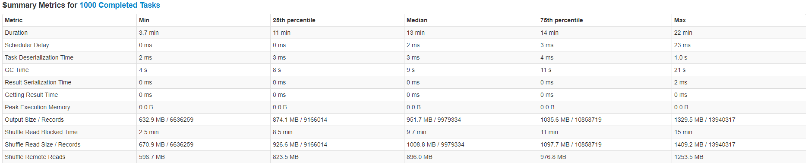
Stage 2 performance breakdown (HDD+TCP/IP)

Slide 43
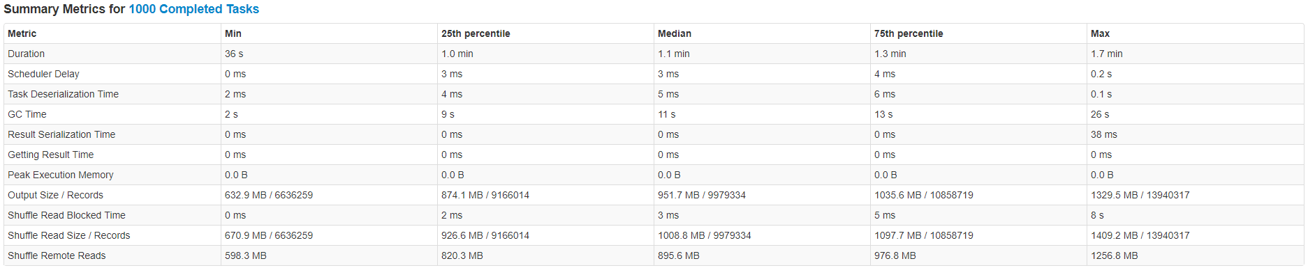
Stage 2 performance breakdown (PMEM+RDMA)

Slide 44
Spark PMoF with shuffle intensive workloads
Modified terasort
  Shuffle intensive workloads, removed sort
  Profiling showed majority of the CPU% were spend on TimSort(), and the shuffle read part is only a small portion of the task.
  We modified terasort workload to explore more performance benefit for shuffle intensive workloads.
  81x speedup compared with HDD, 2x speedup compared with NVMe.
Lower is better

Slide 45
Resource utilization
Spark PMoF significant reduced system utilization
  Higher user%, higher performance
  System% CPU reduced from ~11% to ~3%

Slide 46
Agenda
Background and motivation
Bigdata analytics on the cloud: the challenges & optimizations
Accelerate bigdata analytics on cloud with in memory data accelerator (IMDA)
  IMDA as Cache
  IMDA as shuffle
Summary

Slide 47
Summary
Bigdata analytics is the key cloud workload, customer is adopting
Lots of challenges running Bigdata analytics on public cloud, including functionality, simplicity, performance gaps
With bigdata analytics on public cloud, a new high performance, low latency in memory data accelerator leveraging state-of-art HW technologies can help to address the performance gaps
POC with Alluxio IMDA as Cache and Spark PMoF as shuffle demonstrated significant performance and latency improvement

Slide 48


Rate today ’s session
Session page on conference website
O’Reilly Events App

Slide 49
Notices and Disclaimers
No license (express or implied, by estoppel or otherwise) to any intellectual property rights is granted by this document.
Intel disclaims all express and implied warranties, including without limitation, the implied warranties of merchantability, fitness for a particular purpose, and non-infringement, as well as any warranty arising from course of performance, course of dealing, or usage in trade.
This document contains information on products, services and/or processes in development. All information provided here is subject to change without notice. Contact your Intel representative to obtain the latest forecast, schedule, specifications and roadmaps.
The products and services described may contain defects or errors known as errata which may cause deviations from published specifications. Current characterized errata are available on request.
Intel, the Intel logo, Xeon, Optane, Optane DC Persistent Memory are trademarks of Intel Corporation in the U.S. and/or other countries.
*Other names and brands may be claimed as the property of others
© Intel Corporation.
Notes:
Template 5 - SSG Technical Collateral:
Recommended use: for technical collateral created by SSG.
Found here: http://legal.intel.com/Marketing/Pages/Notices-Disclaimers-Examples.aspx
IF APPLICABLE, add the FTC Optimization Notice: http://legal.intel.com/Marketing/Pages/Performance-disclaimer.aspx#GetHelp
In addition, on the pages where the claims are made: Use footnotes for specific claims (especially if you quote a number, e.g. ‘25% faster’).
At the bottom of the page (or in the same viewing plane), include all of the following: (FOOTNOTE NUMBER) As measured by [List Which Test Used to support this claim]
§ Software and workloads used in performance tests may have been optimized for performance only on Intel microprocessors. Performance tests, such as SYSmark and MobileMark, are measured using specific computer systems, components, software, operations and functions. Any change to any of those factors may cause the results to vary. You should consult other information and performance tests to assist you in fully evaluating your contemplated purchases, including the performance of that product when combined with other products.
§ Configurations: [describe config + what test used + who did testing].
§ For more information go to http://www.intel.com/performance.

Slide 50
Legal Information: Benchmark and Performance Disclaimers
Performance results are based on testing as of Feb. 2019 and may not reflect all publicly available security updates. See configuration disclosure for details. No product can be absolutely secure.
Software and workloads used in performance tests may have been optimized for performance only on Intel microprocessors. Performance tests, such as SYSmark and MobileMark, are measured using specific computer systems, components, software, operations and functions. Any change to any of those factors may cause the results to vary. You should consult other information and performance tests to assist you in fully evaluating your contemplated purchases, including the performance of that product when combined with other products. For more information, see Performance Benchmark Test Disclosure.
Configurations: see performance benchmark test configurations.

